Slide 1
If I Only Had to Train: Implementing a Sustainable Training Plan as You Juggle Many Hats
Kate Miller, Project HOPE-VA
Janelle Taylor-Johnson, PhD, Richmond City Public Schools Paige Walters, Montgomery County Public Schools Leslie Hytonen, York County Public Schools

Slide 2
Agenda
LIAISON RESPONSIBILITIES
AVAILABLE TOOLS
LIAISON PANEL
Q/A

Slide 3
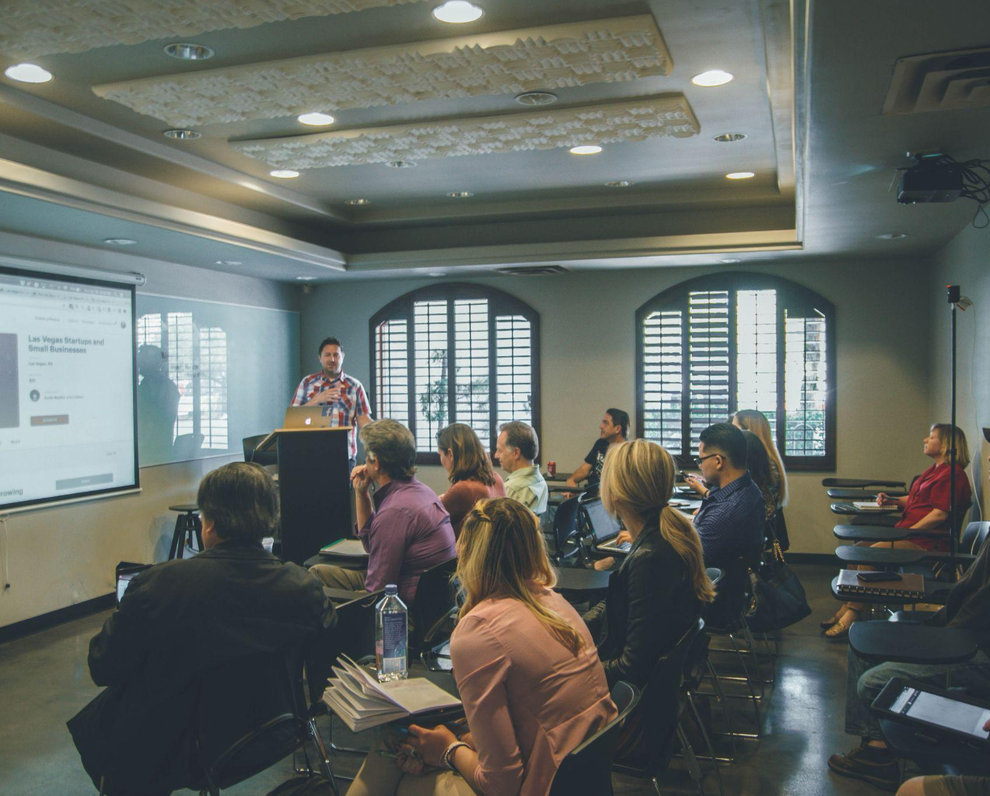
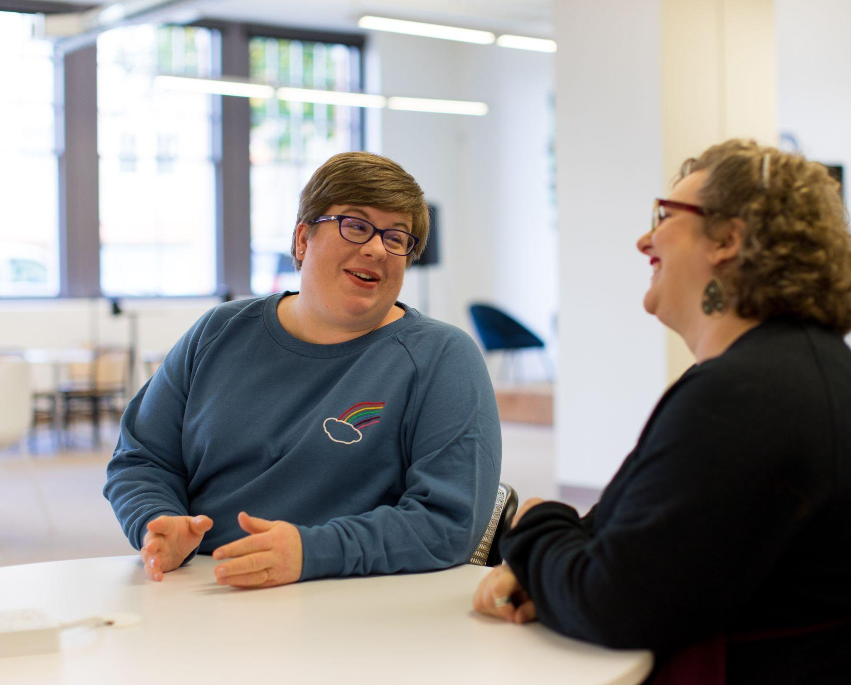
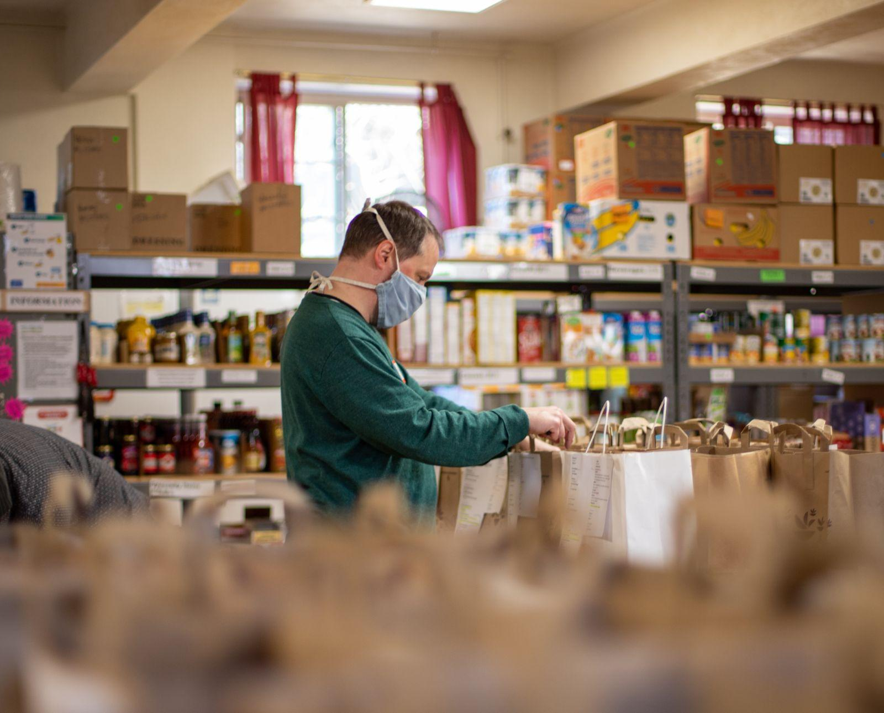
Liaison Responsibilities
Identification
Professional Development
Enrollment &
Success
Access
find them!
including UHY
to preschool programs
Key consideration: Is the purchase reasonable and necessary?
Parent Information
Transportation
Referrals
Dispute Resolution
to school of origin
and participation
to community services
process is followed
Notes:
Highlight 10 liaison responsibilities and how effective staff training will help liaisons to better execute each of these.

Slide 4
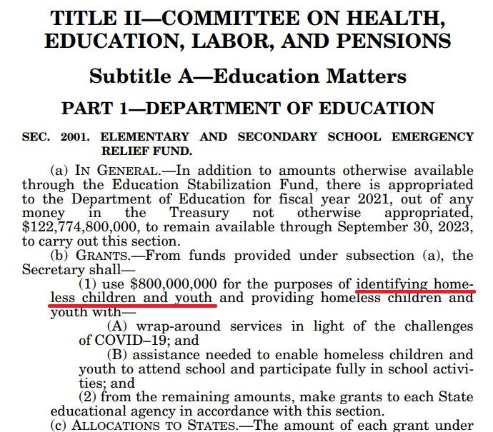
Identification
Liaisons must ensure that…
children and youth experiencing homelessness are identified by school personnel through outreach and coordination activities with other entities and agencies;
[42 U.S.C. §11432(g)(6)(A)]

Slide 5
Training
School personnel providing services to students experiencing homelessness receive professional development and other support.
[42 U.S.C. §11432(g)(6)(A)]
Liaisons must ensure that…
This Photo by Unknown Author is licensed under CC BY-SA-NC

Slide 6
Notes:
Highlight the importance of school staff awareness and impact it has on our students.

Slide 7
RAISING AWARENESS WITH EVERYONE
Recommended Book List
Notes:
List of books by grade level - helpful for raising awareness about the barriers that our students face among the whole school community – great for classrooms or counselors.

Slide 8
TOOLS FOR BUILDING A PLAN
Needs Assessment Worksheet
Staff Training Tip Sheet
Blank and Sample Training Plan
Notes:
Available in the Liaison Portal resource library!

Slide 9
Training videos, quick guides, and tip sheets for local school staff and early childhood educators!
www.projecthopevirginia.org/learning-library
Notes:
Make sure to check out our new learning library.

Slide 10
Learning Library Resources
Notes:
MV videos for school staff and EC educators along with quiz to help you to implement training throughout your division. Also, supplemental short whiteboard videos.

Slide 11
Learning Library Resources
Tip Sheets for each school staff role
Information Briefs
Notes:
Tip sheets also available for download in the learning library to give your trainees something to take with them after training is complete – MV Quick Guide plus role-specific tip sheets.

Slide 12
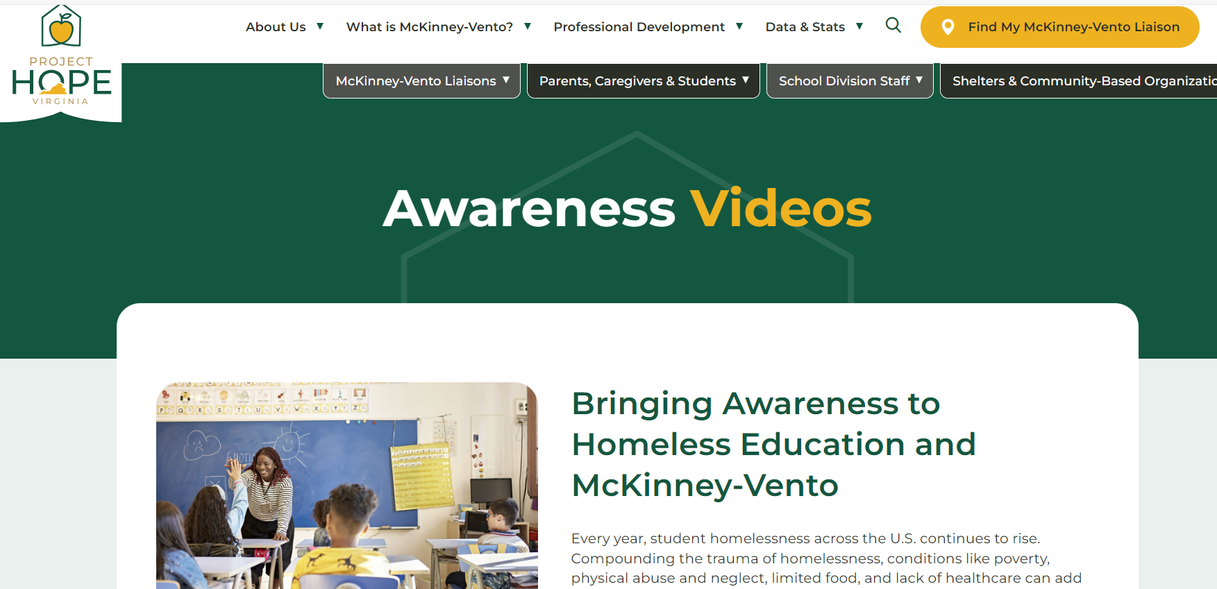
Check out our new awareness videos at www.projecthopevirginia.org/awareness-videos
Notes:
Short 1-minute awareness videos now available to highlight key components of the MV act along with videos specifically for UHY and Early Learners.

Slide 13
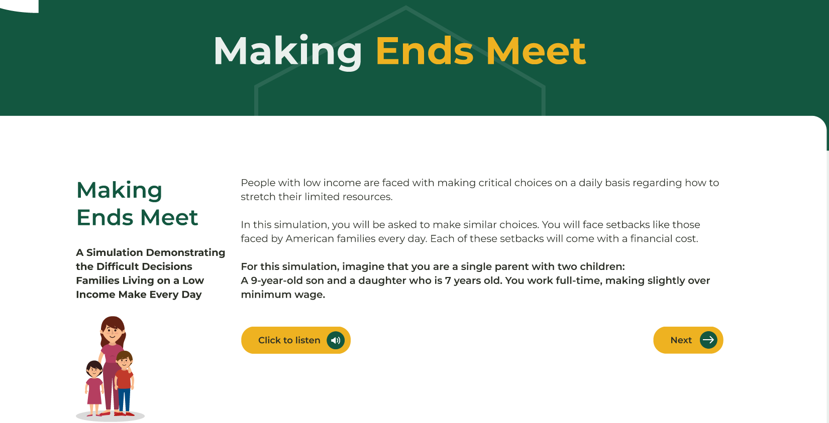
Coming Soon! New Virtual Poverty Simulation
Notes:
New poverty simulation coming soon where users can walk through scenario where they face multiple hardships and, with each hardship, have fewer and fewer resources to afford essential needs like food, transportation, healthcare etc. Similar to our in-person “Making Choices” smarties activity.

Slide 14
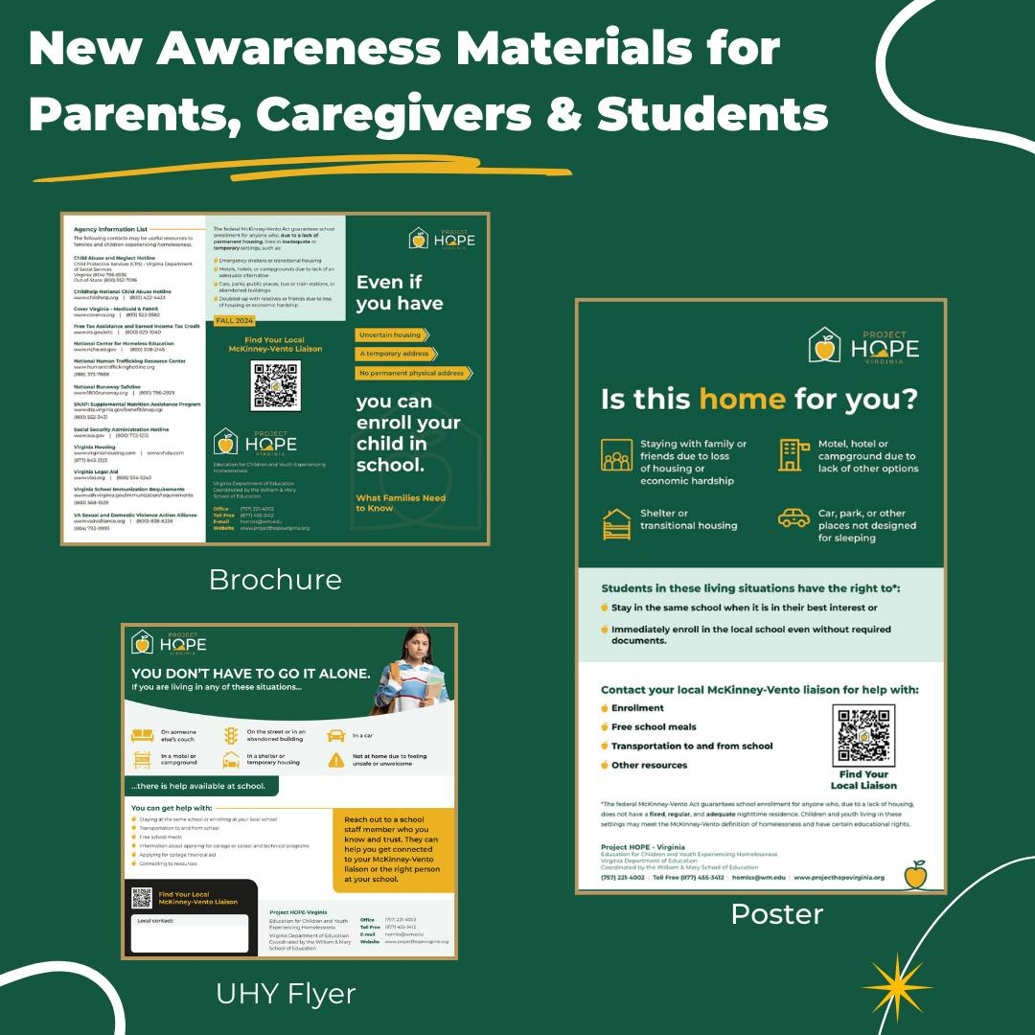
ORDER our awareness materials by visiting www.projecthopevirginia.org/awareness-materials

Slide 15
Welcome Panelists!
Janelle Taylor-Johnson, PhD McKinney-Vento Liaison/ C-FIT Coordinator Richmond City Public Schools
Paige Walters McKinney-Vento Liaison/ Project HOPE New River Valley Coordinator Montgomery County Public Schools
Leslie Hytonen
McKinney-Vento Liaison/ Community Outreach Coordinator York County Public Schools

Slide 16
Thank You!

